Slide 1
CSC479
Data Mining
Classification Lecture 6
Rule Based Classification
(Ch # 8: Data Mining-Concepts and Techniques by Han and Kamber)

Slide 2
Rule Generation from Decision Tree
Decision tree classifiers are popular method of classification due to its easy understanding
However, decision tree can become large and difficult to interpret
In comparison with decision tree, the IF-THEN rules may be easier for humans to understand, particularly if the decision tree is very large

Slide 3
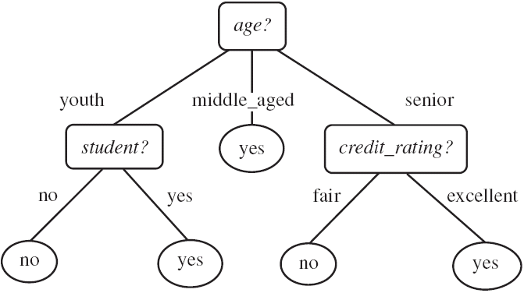
Rule Generation from Decision Tree
Rules are easier to understand than large trees
One rule is created for each path from the root to a leaf
Each attribute-value pair along a path forms a conjunction. The leaf holds the class prediction

Slide 4
Rule Generation from Decision Tree
Example: Rule extraction from our buys_computer decision-tree
IF age = young AND student = no THEN buys_computer = no
IF age = young AND student = yes THEN buys_computer = yes
IF age = mid-age THEN buys_computer = yes
IF age = old AND credit_rating = excellent THEN buys_computer = yes
IF age = young AND credit_rating = fair THEN buys_computer = no

Slide 5
Rule-Based Classifier
Classify records by using a collection of “if…then…” rules
Rule: (Condition) → y
where
Condition is a conjunctions of attributes
y is the class label
LHS: rule antecedent or condition
RHS: rule consequent
Examples of classification rules:
(Blood Type=Warm) ∧ (Lay Eggs=Yes) → Birds
(Taxable Income < 50K) ∧ (Refund=Yes) → Evade=No

Slide 6
Rule-based Classifier (Example)
R1: (Give Birth = no) ∧ (Can Fly = yes) → Birds
R2: (Give Birth = no) ∧ (Live in Water = yes) → Fishes
R3: (Give Birth = yes) ∧ (Blood Type = warm) → Mammals
R4: (Give Birth = no) ∧ (Can Fly = no) → Reptiles
R5: (Live in Water = sometimes) → Amphibians

Slide 7
Application of Rule-Based Classifier
A rule r covers an instance x if the attributes of the instance satisfy the condition of the rule
R1: (Give Birth = no) ∧ (Can Fly = yes) → Birds
R2: (Give Birth = no) ∧ (Live in Water = yes) → Fishes
R3: (Give Birth = yes) ∧ (Blood Type = warm) → Mammals
R4: (Give Birth = no) ∧ (Can Fly = no) → Reptiles
R5: (Live in Water = sometimes) → Amphibians
The rule R1 covers a hawk => Bird
The rule R3 covers the grizzly bear => Mammal

Slide 8


Rule Coverage and Accuracy
Coverage of a rule:
Fraction of records that satisfy the antecedent of a rule
Accuracy of a rule:
Fraction of records that satisfy both the antecedent and consequent of a rule
(Status=Single) → No
Coverage = 40%, Accuracy = 50%

Slide 9
How does Rule-based Classifier Work?
R1: (Give Birth = no) ∧ (Can Fly = yes) → Birds
R2: (Give Birth = no) ∧ (Live in Water = yes) → Fishes
R3: (Give Birth = yes) ∧ (Blood Type = warm) → Mammals
R4: (Give Birth = no) ∧ (Can Fly = no) → Reptiles
R5: (Live in Water = sometimes) → Amphibians
A lemur triggers rule R3, so it is classified as a mammal
A turtle triggers both R4 and R5
A dogfish shark triggers none of the rules

Slide 10
Characteristics of Rule-Based Classifier
Mutually exclusive rules
Classifier contains mutually exclusive rules if the rules are independent of each other
Every record is covered by at most one rule
we can not have rules conflict because no two rules will triggered for the same tuple
Exhaustive rules
Classifier has exhaustive coverage if it accounts for every possible combination of attribute values
Each record is covered by at least one rule
There is one rule for each possible attribute-value combination, so that the set of rules does not require a default rule

Slide 11
From Decision Trees To Rules
Rules are mutually exclusive and exhaustive
Rule set contains as much information as the tree

Slide 12
Rules Can Be Simplified
Initial Rule: (Refund=No) ∧ (Status=Married) → No
Simplified Rule: (Status=Married) → No

Slide 13
Effect of Rule Simplification
Rules are no longer mutually exclusive
A record may trigger more than one rule
Solution?
Ordered rule set
Unordered rule set – use voting schemes
Rules are no longer exhaustive
A record may not trigger any rules
Solution?
Use a default class

Slide 14
Ordered Rule Set
Rules are rank ordered according to their priority
An ordered rule set is known as a decision list
When a test record is presented to the classifier
It is assigned to the class label of the highest ranked rule it has triggered
If none of the rules fired, it is assigned to the default class
R1: (Give Birth = no) ∧ (Can Fly = yes) → Birds
R2: (Give Birth = no) ∧ (Live in Water = yes) → Fishes
R3: (Give Birth = yes) ∧ (Blood Type = warm) → Mammals
R4: (Give Birth = no) ∧ (Can Fly = no) → Reptiles
R5: (Live in Water = sometimes) → Amphibians

